Slide 1


DIWALI SALES REPORT
Name - Aditya Maurya
Reg no. – 12206243
Email- mauryaaditya7565@gmail.com

Slide 2

Outline
Introduction
Methodology
Results
Visualization –Charts
Conclusion

Slide 3


INTRODUCTION
Analysis parameter of Diwali sales data
Gender analysis
Marriage Status
Age Group
State
Occupation
Product category
Product ID

Slide 4

METHODOLOGY
1. Data Loading: Load the Diwali sales dataset into the code using the pandas library Perform initial data exploration to understand the structure and content of the dataset
2. Data Cleaning and Manipulation: Handle missing values, remove duplicates, and perform necessary data transformations. This step ensures the data is in a suitable format for analysis.
3. Exploratory Data Analysis (EDA): Use pandas matplotlib, and seaborn libraries to explore the dataset Analyze different variables, their distributions, and relationships Generate various visualizations such as bar plots pie charts, and scatter plots to uncover patterns and trends.
4 Customer Analysis: Analyze customer demographics such as state occupations, gender, and age groups to identify potential customers. Use bar plots or pie charts to visualize the distribution of customers across different categories.
5 Product Sales Analysis: Determine the most selling product categories and specific products during The Diwali Festival Utilize bar plots or pie charts to visualize the sales quantities and identify the Top-selling items

Slide 5
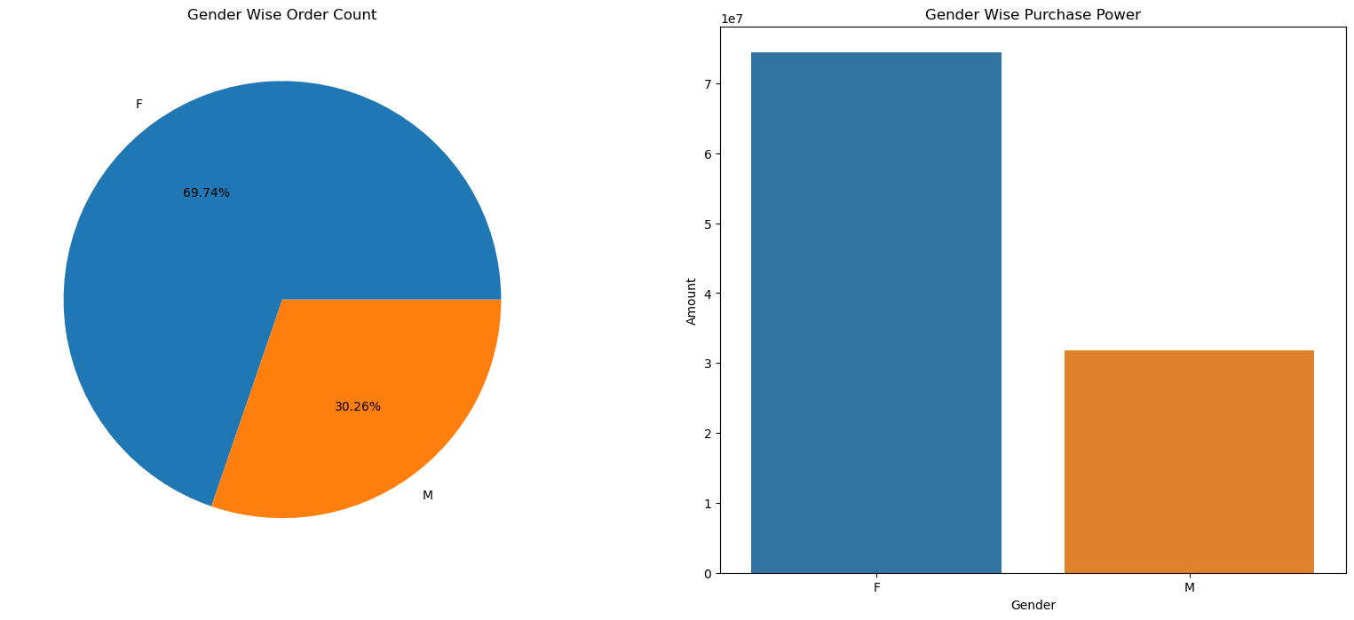
RESULTS
Gender wise
Generally, women tend to place more orders and have higher purchasing power. This makes them a significant group for businesses.

Slide 6

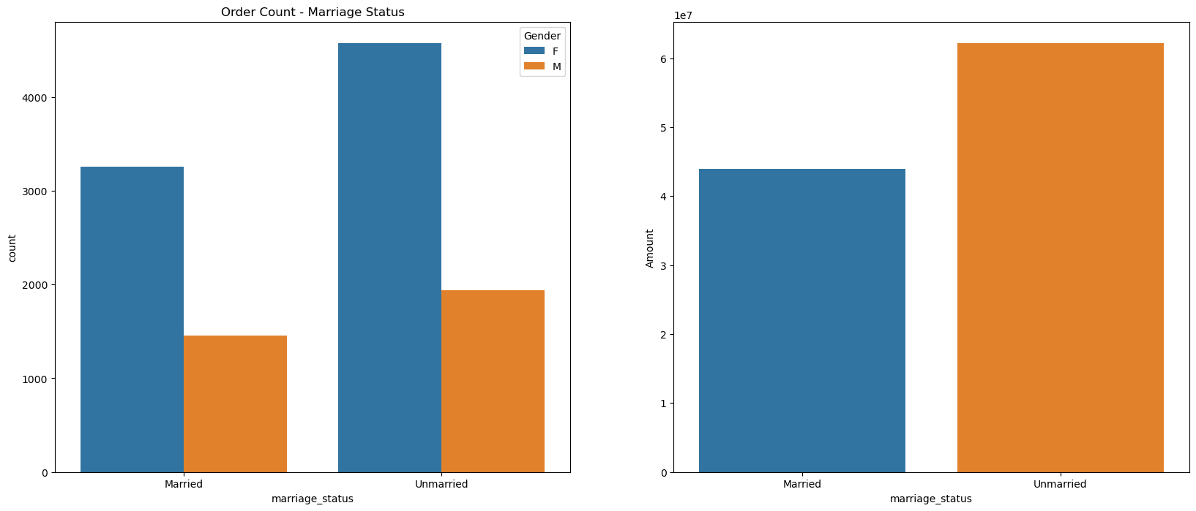
Marriage Status
unmarried women place more orders than both married women and unmarried men. Their higher buying activity makes them very important for sales. Businesses should focus on this group to boost their growth and earnings.

Slide 7
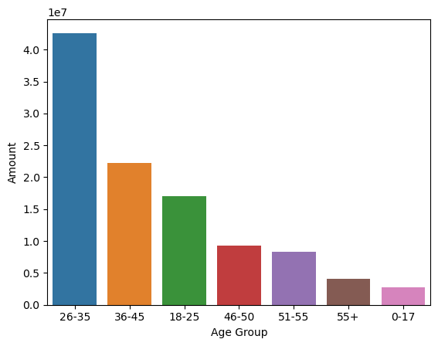
Age Group
The chart presented above indicates that the age group of 26-35 made the highest number of purchases, while the age group of 55+ made the least. Moreover, the data shows that females are the primary purchasers across all age groups, regardless of age range.

Slide 8

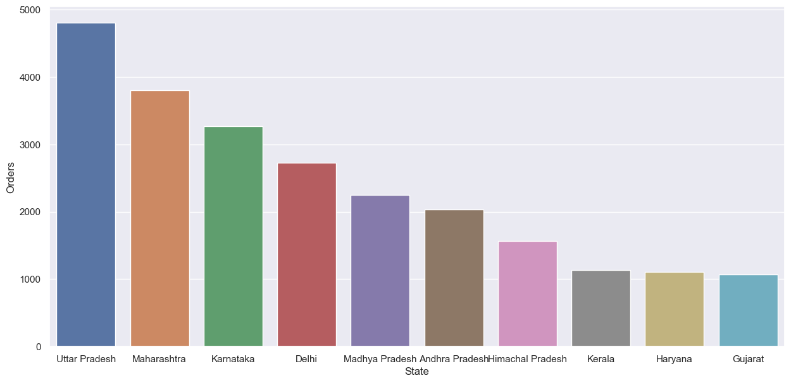
State
Based on the above graphs, it is evident that the states of Uttar Pradesh, Maharashtra, and Karnataka contribute significantly to the majority of the orders and total sales/amount.

Slide 9

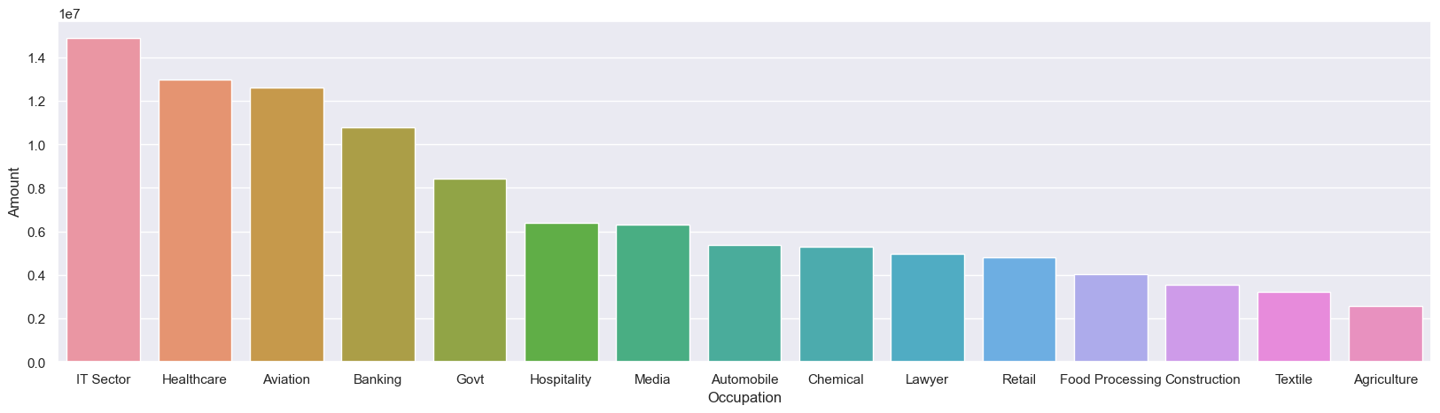
Occupation
the data clearly shows that a large number of buyers come from the Information Technology, Healthcare, and Aviation industries.

Slide 10
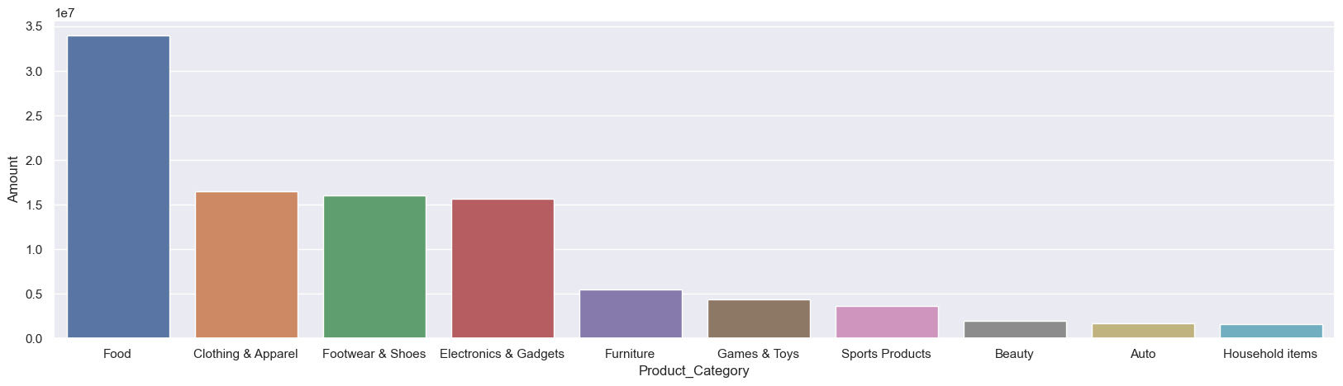
Product category
the graphs reveal that Food, Clothing, and Electronics are the top-selling product categories

Slide 11
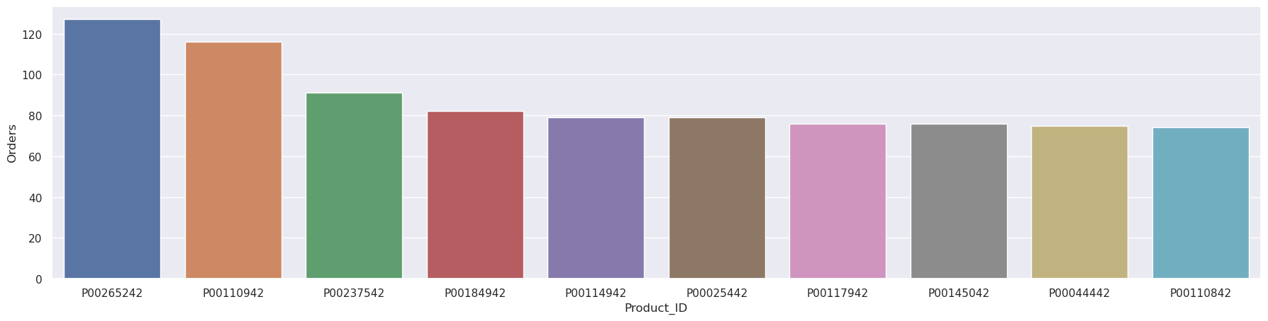
Product ID

Slide 12
Conclusion
Married women age group 26-35 years from UP,
Maharashtra and Karnataka working in IT,
Healthcare and Aviation are more likely to buy products from Food,
Clothing and Electronics category

